Slide 1
Beg Borrow Steal
As an early idea generation activity
As an idea refinement activity

Slide 2
1) Early idea generation
Use this alongside your stimuli to generate new ideas. Best done in groups.
Go through each question in turn. Make sure you have a space for people to put down ideas either online on in the room - a big A2 sheet would work for this.
What is our audience asking (begging) for? There should be people in the room who have regular contact with them and know what they want.
Borrow – taking inspiration from other things in the market, other charities or businesses are doing, trends in the media. E.g. Greggs and Primark collab – what if we collaborated with a high street retailer?
Steal – directly taking an idea or concept from another organisation or business. E.g. Greggs and Primark collab – what if we collaborated with Greggs.

Slide 3
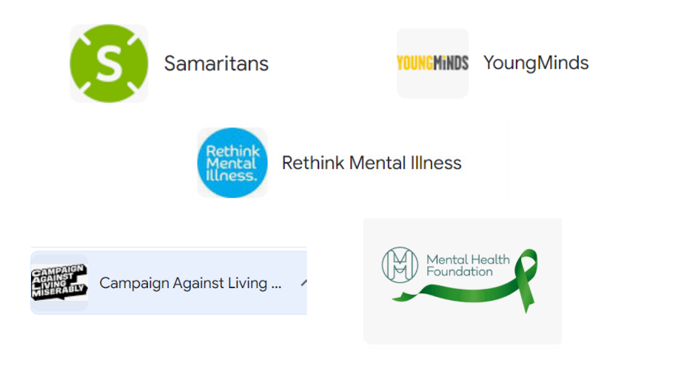
What would ........ look like if it was done by our competitors?

Slide 4
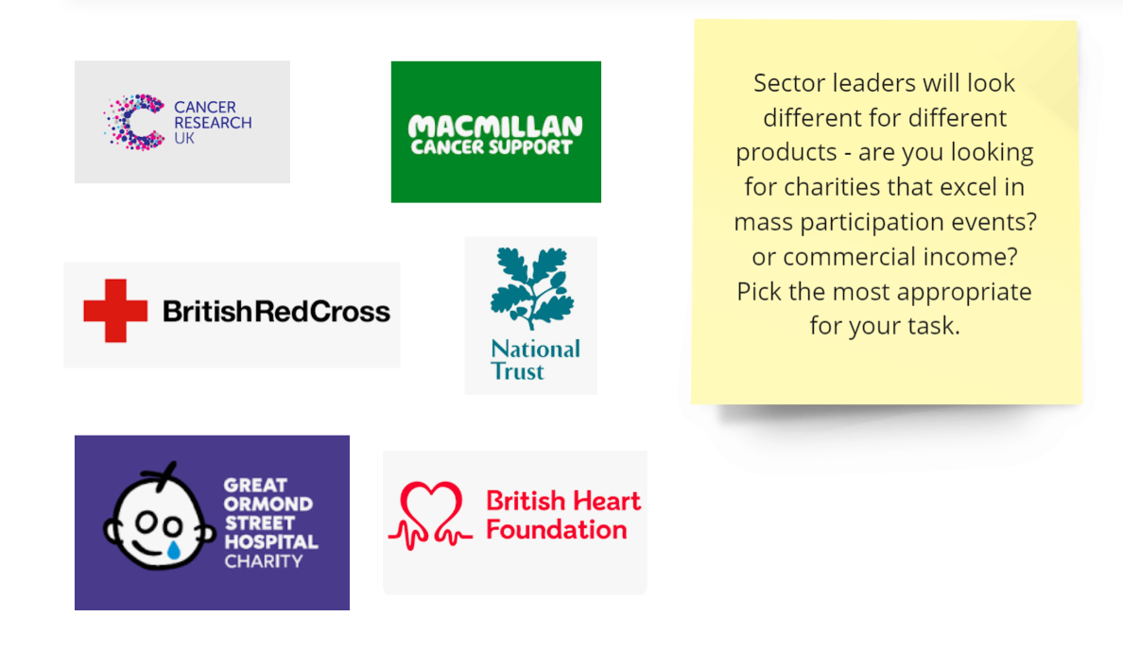
What would ........ look like if it was done by leaders in the charity sector?

Slide 5
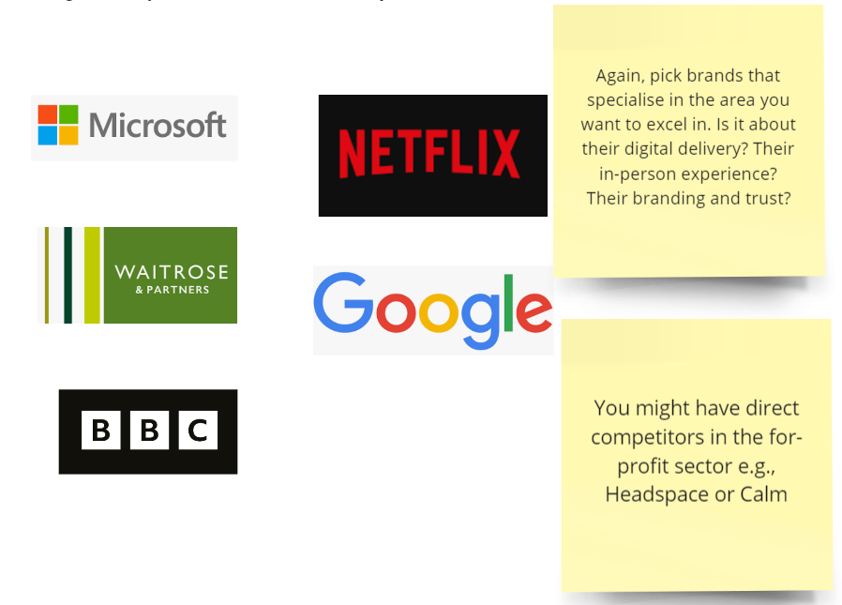
What would ........ look like if it was done by corporations (for profit)?

Slide 6
2) Refinement activity
Example refinement activity. This is a way of using Beg Borrow Steal, but for refinement so it’s focused on the attributes you want your product to have.
Split people into groups of 2-4.
Each group will get a table like the one below.
The company (highlighted) will be different for each group. Each company you choose should have a reputation for something you want your product/concept to have. E.g., if you want Pause to be backed by science, you’d choose the journal Nature as your company. If you wanted it to be excellent customer service you might choose British Airways. You need to decide your attributes and the companies that reflect these.
The groups can all work on the same concepts (if you’ve narrowed it down to 3-5 concepts before starting this exercise) because they will pull out different things depending on the company they are focusing on. When it comes to feeding back, focus on one concept at a time. Each group should give their refinement of concept 1 before moving on to concept 2.

Slide 7
Example template for Beg Borrow Steal
Concept | What it would look like if Netflix did it | What are the key experiences? | What does it look like for Mind
Concept 1 – e.g. Making paper flowers | Episodes/series format Well known host/actor giving instructions Watch at own pace Something to talk to friends/colleagues about | Breaks it down into chucks – easy to understand and do in own time Something you want to talk about/share | Step-by-step guides that you can pause/go back to A space to share your results/get tips – could this be on Instagram and the Pause account share them? Best one of the month gets a prize?
Concept 2
Concept 3

