Slide 1
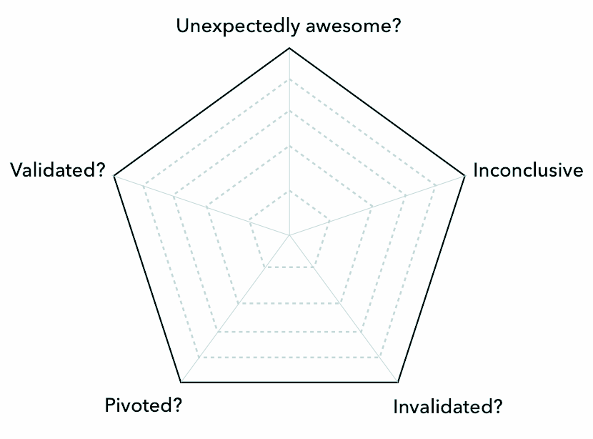
ASSUMPTION LEARNING CARD
Use this tool to collect and refine your learnings after testing your critical assumptions.
IDEA NAME
Assumption tested
Which specific assumption or hypothesis did you test?
(In)validation?
Key findings
What have you learned and discovered?
(In)validated learning evidence
What did users tell you? What did they say? How do you know?
To do
What are the next steps? Further tests, pivot, improve…
Notes:
STEP 1
Define the assumptions or hypotheses you’re testing.
STEP 2
Run your experiment (see experiment cards) and write down your key learnings and insights.
STEP 3
Write down in what way your validations held true – or didn’t. Write down the evidence you have for this (in)validation.
STEP 4
Complete the spider diagram to show how much (in)validation you obtained on this particular assumption. Ask yourself if you need to run further or broader experiments on this particular assumption.
STEP 5
Define clear next steps. Perhaps you need further validated learning evidence or need to test new assumptions that emerged as a result. Either way, clearly define your next steps

