Slide 1
How Might We
Guidance and template

Slide 2
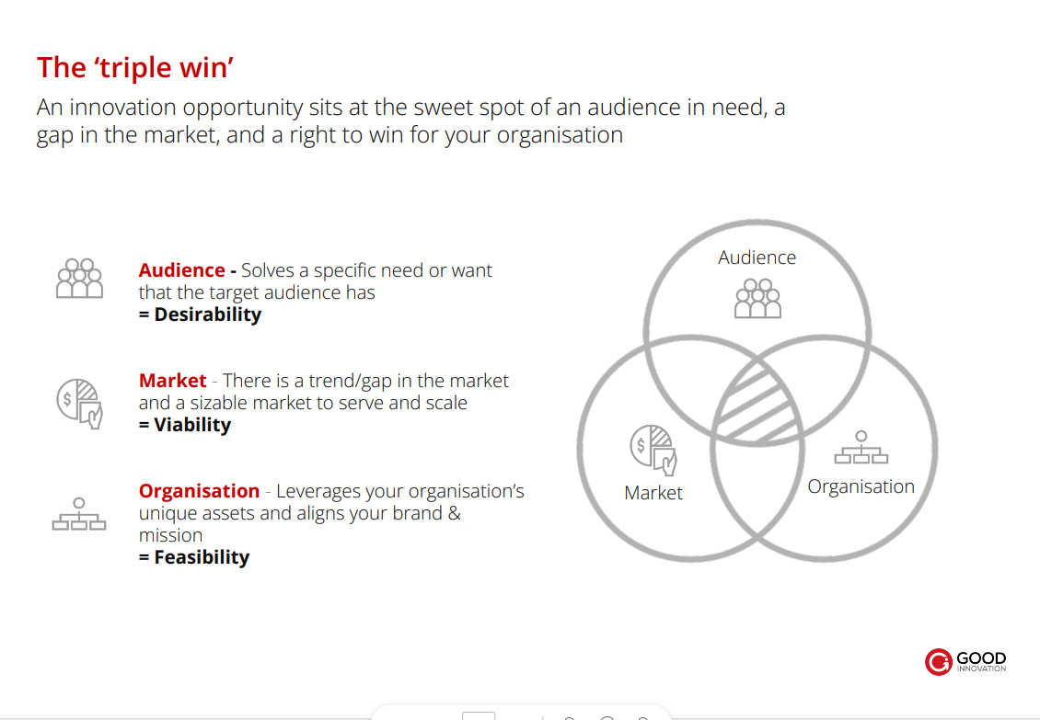

Slide 3
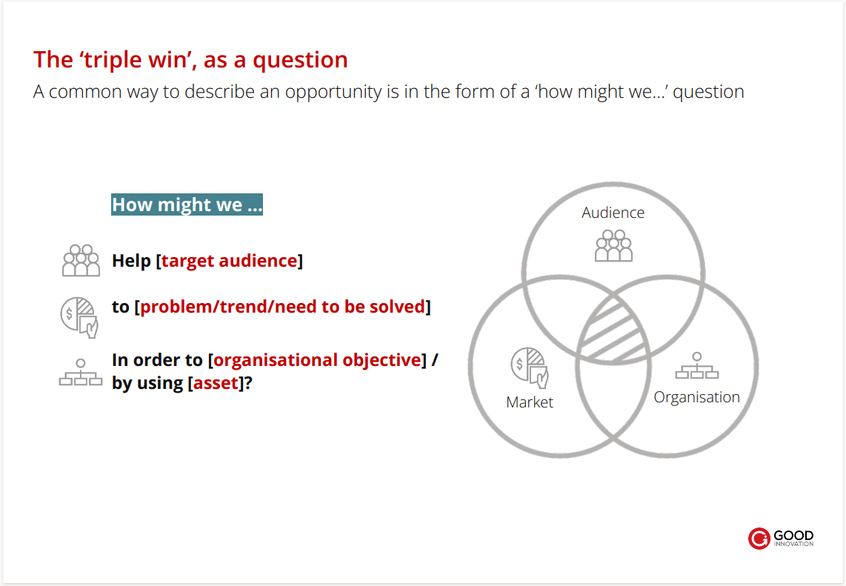

Slide 4
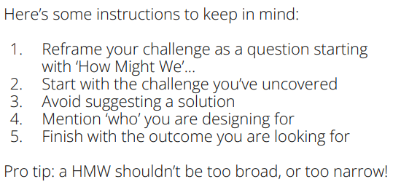

Slide 5
How Might We (HMW) statement builder
Action – you want to achieve e.g., redesign, encourage, improve, change | Subject – to be influenced or impacted e.g., millennials, Pause subscribers, CEOs | Outcome – you would like to ideally achieve e.g., donate, participate

